Slide 1
Representation with Logic (Chapters 7-9)
Dr. Shengquan Wang
Most slides are adopted from
Artificial Intelligence: A Modern Approach, 3rd ed. by Stuart Russell (UC Berkeley) and Peter Norvig (Google).
Peter Norvig and Sebastian Thrun for Intro to Artificial Intelligence at Udacity.
Tian-Li Yu for Artificial Intelligence - Search & Logic at Coursera.

Slide 2
AI Design Space
Knowledge Representation
Logic (Sentences)
Environment
Stochastic, Partial observable
Variables (Words)
Deterministic,
Full observable
Agent Design
Goal-based/ Utility-based
Reflex

Slide 3
Outline
Knowledge-based Agents

Slide 4

A Knowledge-based Agent
Agent
Query
Inference engine
KB
Conclusion
Knowledge base (KB):
Stores knowledge, which is represented by sentences in a particular knowledge representation language.
Inference engine:
Draws conclusions in new sentences to answer questions, solve problems, or suggest actions to perform to achieve goals.
Notes:
https://www.cs.utexas.edu/~mooney/cs343/slide-handouts/logic.4.pdf

Slide 5
Knowledge Representation Language
sentences
sentence
Entails
Representation
Environment
Semantics
Semantics
Follows
facts
fact
Syntax defines the sentences in the language.
Semantics defines the “meaning” of sentences, i.e., define truth of a sentence in a world.
Logical inference (deduction) derives new sentences in the language from existing ones.

Slide 6
Knowledge Representation Language
Propositional logic
First order logic

Slide 7
Outline
Knowledge-based Agents
Propositional Logic
Basics

Slide 8
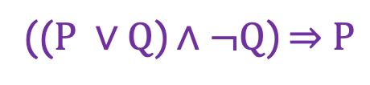
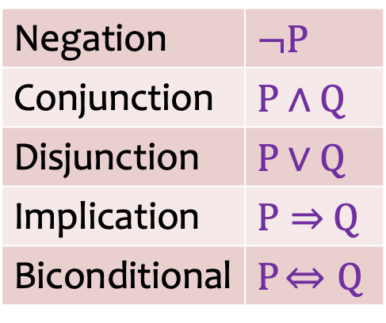
Propositional Logic: Syntax
Boolean proposition symbol:
P
Q
Logical connectives:
The atomic sentences consist of a single Boolean proposition symbol.
Complex sentences are constructed from atomic sentences, using parentheses and logical connectives.
Negation | $$¬P$$
Conjunction | $P$ $∧$ $Q$
Disjunction | $P$ $∨$ $Q$
Implication | $P⇒$ $Q$
Biconditional | $P$ $⇔Q$
(($P ∨Q$) $∧¬Q$) $⇒$ $P$

Slide 9

Semantics: Truth Tables for Connectives
P | Q | $¬$P | P$∧$Q | P$∨$Q | P$⇒$Q | P$⇔$Q
F | F | T | F | F | T | T
F | T | T | F | T | T | F
T | F | F | F | T | F | F
T | T | F | T | T | T | T

Slide 10
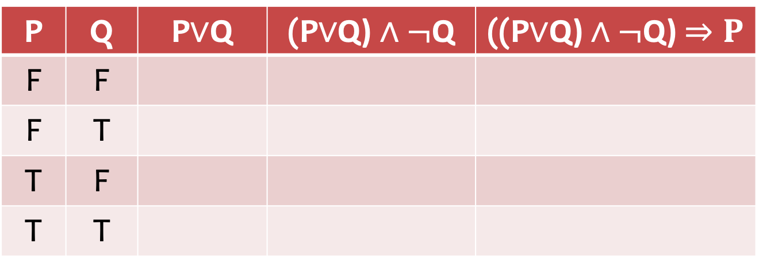
Quiz
P | Q | P$∨$Q | (P$∨$Q) $∧¬$Q | ((P$∨$Q) $∧¬$Q) $⇒P$
F | F
F | T
T | F
T | T

Slide 11
Quiz: Solution
P | Q | P$∨$Q | (P$∨$Q) $∧¬$Q | ((P$∨$Q) $∧¬$Q) $⇒P$
F | F
F | T
T | F
T | T
F
F
T
T
F
T
T
T
T
T
F
T

Slide 12
Logical Equivalence
(P ∧ Q) ≡ (Q ∧ P) commutativity of ∧
(P ∨ Q) ≡ (Q ∨ P) commutativity of ∨
((P∧Q)∧R) ≡ (P∧(Q∧R)) associativity of ∧
((P∨Q)∨R) ≡ (P∨(Q∨R)) associativity of ∨
¬(¬P) ≡ P double-negation elimination
(P ⇒ Q) ≡ (¬Q ⇒ ¬P) contraposition
(P ⇒ Q) ≡ (¬P ∨ Q) implication elimination
(P ⇔ Q) ≡ ((P ⇒ Q) ∧ (Q ⇒ P)) biconditional elimination
¬(P∧Q) ≡ (¬P∨¬Q) De Morgan
¬(P∨Q) ≡ (¬P∧¬Q) De Morgan
(P∧(Q∨R)) ≡ ((P∧Q)∨(P∧R)) distributivity of ∧ over ∨
(P∨(Q∧R)) ≡ ((P∨Q)∧(P∨R)) distributivity of ∨ over ∧

Slide 13
Quiz
P | Q | P ⇒ Q | ¬Q ⇒ ¬P | ¬P ∨ Q
F | F
F | T
T | F
T | T

Slide 14
Answer
P | Q | P ⇒ Q | ¬Q ⇒ ¬P | ¬P ∨ Q
F | F
F | T
T | F
T | T
T
T
T
T
T
T
F
F
F
T
T
T

Slide 15
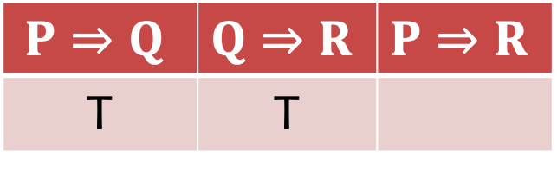
Quiz: Proving Chain Rule
$$P⇒Q$$ | $$Q⇒R$$ | $$P⇒R$$
T | T
T

Slide 16

Answer: Proof of Chain Rule
P | Q | R | $$P⇒Q$$ | $$Q⇒R$$ | $$P⇒R$$
F
T
T
T
T
T
T
T
T
T

Slide 17
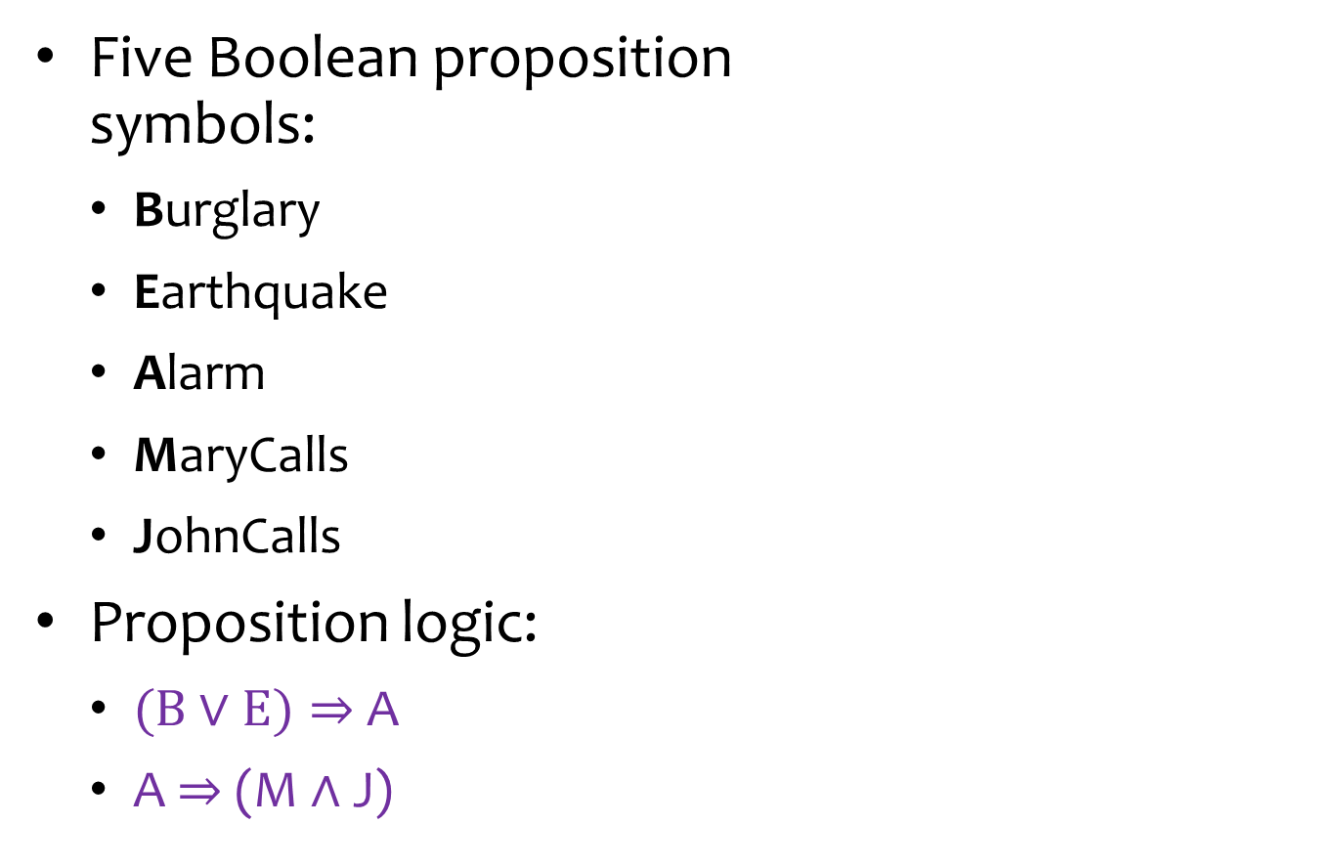
Example: Alarm
Five Boolean proposition symbols:
Burglary
Earthquake
Alarm
MaryCalls
JohnCalls
Proposition logic:
($B$ $∨$ $E)⇒$ A
A $⇒$ (M $∧$ J)
Burglary
Earthquake
Alarm
MaryCalls
JohnCalls

Slide 18
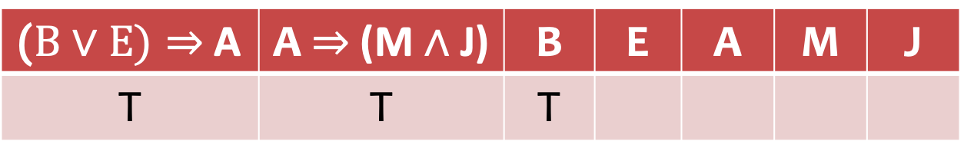
Quiz
Burglary
Earthquake
Alarm
MaryCalls
JohnCalls
($B$ $∨$ $E)⇒$ A | A $⇒$ (M $∧$ J) | B | E | A | M | J
T | T | T

Slide 19
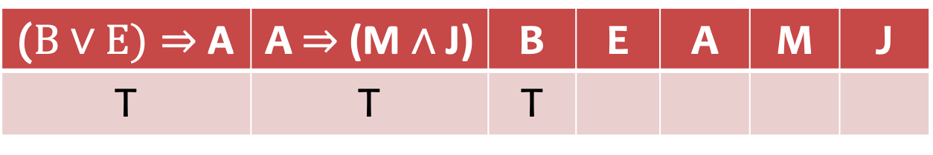
Answer
Burglary
Earthquake
Alarm
MaryCalls
JohnCalls
($B$ $∨$ $E)⇒$ A | A $⇒$ (M $∧$ J) | B | E | A | M | J
T | T | T
?
T
T
T

Slide 20
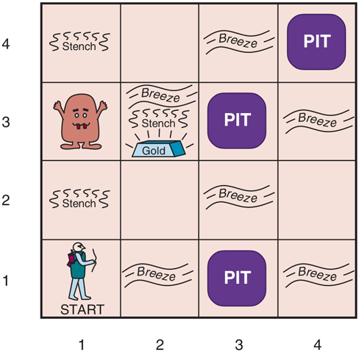
Example: Wumpus World
PerformanceMeasure | gold: +1000 death (into a pit or eaten by wumpus): -1000 1 step: -1 using the arrow: -10
Environment | (1,1): cave entrance and exit squares adjacent to wumpus are smelly squares adjacent to pit are breezy glitter iff gold is in the same square walk into a wall and bump shoot directly at wumpus no matter how far, it will scream and die, and the only arrow will be used up grab/release the gold if in same square
Actuators | Left/right turn; forward; grab, release; shoot
Sensors | smell; breeze; glitter; bump; scream

Slide 21
Wumpus World Characterization
Partially observable: only local perception
Deterministic: outcomes exactly specified
Sequential: at the level of actions
Static: Wumpus and Pits do not move
Discrete: grid
Single-agent: Wumpus is essentially a natural feature

Slide 22

Exploring a Wumpus World
OK
OK
OK

Slide 23
Exploring a Wumpus World
?Pit
OK
Breeze
?Pit
OK
OK

Slide 24
Exploring a Wumpus World
?Pit
OK
Breeze
?Pit
?Wumpus
OK
OK
Smell
?Wumpus

Slide 25
Exploring a Wumpus World
?Pit
Pit
OK
Breeze
?Pit
?Wumpus
OK
OK
OK
Smell
?Wumpus
Wumpus

Slide 26
Exploring a Wumpus World
Pit
OK
OK
Breeze
OK
OK
OK
OK
Smell
Wumpus

Slide 27
Exploring a Wumpus World
Pit
OK
OK
Breeze
OK
OK
Breeze
Glitter
Smell
OK
OK
Smell
Wumpus

Slide 28
Given a KB, how can we check if an inference is true?

Slide 29
Outline
Knowledge-based Agents
Propositional Logic
Basics
Propositional Theorem Proving

Slide 30
A Knowledge-based Agent
Agent
Query
Inference engine
KB
Conclusion
Knowledge base (KB):
Stores knowledge, which is represented by sentences in a particular knowledge representation language.
Inference engine:
Draws conclusions in new sentences to answer questions, solve problems, or suggest actions to perform to achieve goals.
Notes:
https://www.cs.utexas.edu/~mooney/cs343/slide-handouts/logic.4.pdf

Slide 31

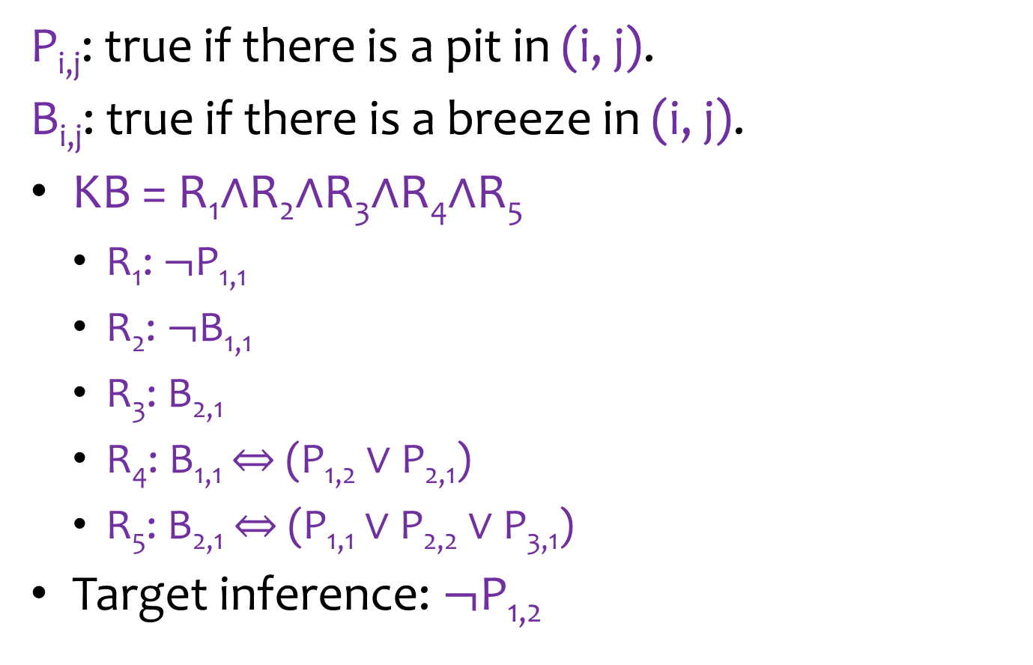


Wumpus World Sentences
P_{i,j}: true if there is a pit in (i, j).
B_{i,j}: true if there is a breeze in (i, j).
KB = R₁$∧$R₂$∧$R₃$∧$R₄$∧$R₅
R₁: $¬$P_{1,1}
R₂: $¬$B_{1,1}
R₃: B_{2,1}
R₄: B_{1,1} $⇔$ (P_{1,2} $∨$ P_{2,1})
R₅: B_{2,1} $⇔$ (P_{1,1} $∨$ P_{2,2} $∨$ P_{3,1})
Target inference: $¬\text{P}\text{1,2}$
4
3
2
B_{2,1}
$¬$P_{1,1}
1
$$¬\text{P}\text{1,2}$$
$¬$B_{1,1}
1
2
3
4

Slide 32




Proving through Enumeration
4
3
If KB is true in row, $\text{P}\text{1,2}$ is false.
2
B_{2,1}
O(2^{n}) for n symbols.
$¬$P_{1,1}
1
$$¬\text{P}\text{1,2}$$
$¬$B_{1,1}
1
2
3
4

Slide 33

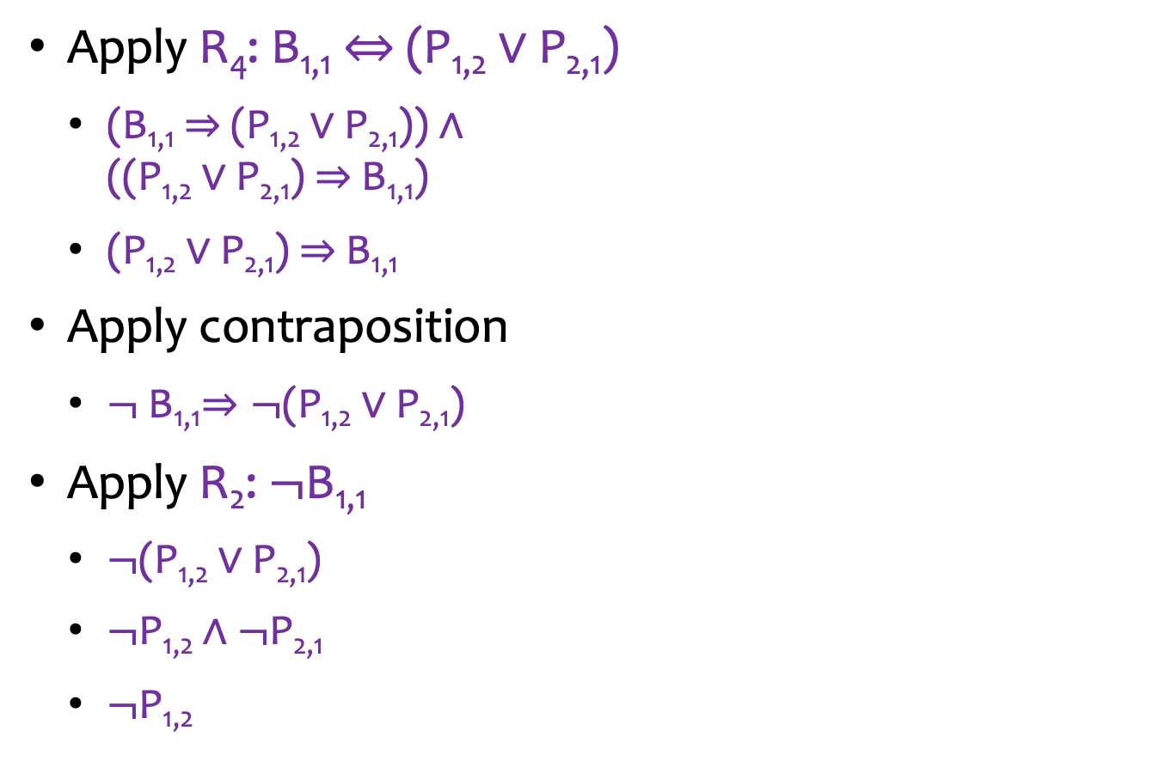
Propositional Theorem Proving
Apply R₄: B_{1,1} $⇔$ (P_{1,2} $∨$ P_{2,1})
(B_{1,1}$⇒$(P_{1,2} $∨$ P_{2,1})) $∧$ ((P_{1,2} $∨$ P_{2,1}) $⇒$B_{1,1})
(P_{1,2} $∨$ P_{2,1}) $⇒$B_{1,1}
Apply contraposition
$¬$B_{1,1}$⇒¬$(P_{1,2} $∨$ P_{2,1})
Apply R₂: $¬$B_{1,1}
$¬$(P_{1,2} $∨$ P_{2,1})
$¬$P_{1,2}$∧¬$P_{2,1}
$¬\text{P}\text{1,2}$
4
3
2
B_{2,1}
$¬$P_{1,1}
1
$$¬\text{P}\text{1,2}$$
$¬$B_{1,1}
1
2
3
4

Slide 34
Propositional Theorem Proving
The inference path is derived by hand with human intelligence.
How can an intelligent agent perform such inference in general?
Proof by Resolution

Slide 35
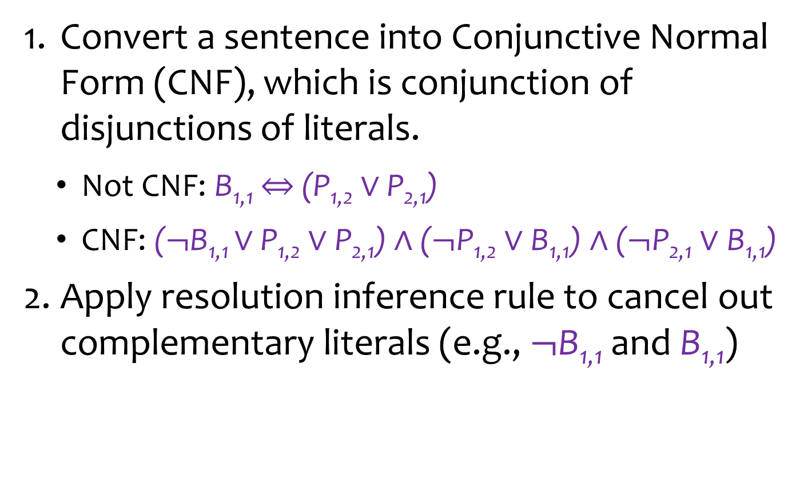
Proof by Resolution
Convert a sentence into Conjunctive Normal Form (CNF), which is conjunction of disjunctions of literals.
Not CNF: B_{1,1} $⇔$ (P_{1,2} $∨$ P_{2,1})
CNF: ($¬$B_{1,1} $∨$ P_{1,2} $∨\text{P}\text{2,1}$) $∧$ ($¬\text{P}\text{1,2}∨\text{B}\text{1,1}$) $∧$ ($¬\text{P}\text{2,1}∨\text{B}\text{1,1}$)
Apply resolution inference rule to cancel out complementary literals (e.g., $¬$B_{1,1} and B_{1,1})

Slide 36
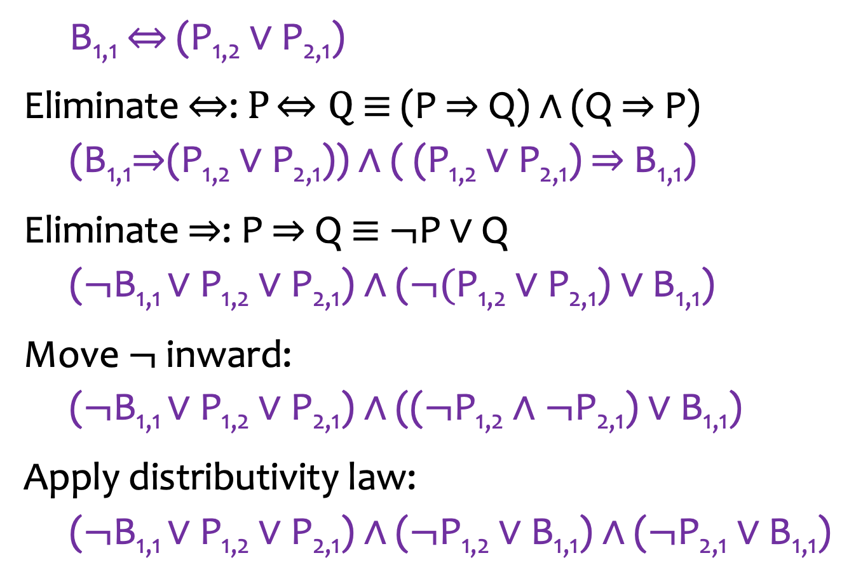
1. Converting to CNF
B_{1,1} $⇔$ (P_{1,2} $∨$ P_{2,1})
Eliminate $⇔$: $P$ $⇔Q$ ≡ (P $⇒$Q) $∧$ (Q $⇒$P)
(B_{1,1}$⇒$(P_{1,2} $∨$ P_{2,1})) $∧$ ( (P_{1,2} $∨$ P_{2,1}) $⇒$B_{1,1})
Eliminate $⇒$: P $⇒$Q ≡ $¬$P $∨$ Q
($¬$B_{1,1} $∨$ P_{1,2} $∨\text{P}\text{2,1}$) $∧$ ($¬\text{(}\text{P}\text{1,2}∨\text{P}\text{2,1}\text{)}∨\text{B}\text{1,1}$)
Move $¬$ inward:
($¬$B_{1,1} $∨$ P_{1,2} $∨\text{P}\text{2,1}$) $∧$ (($¬\text{P}\text{1,2}∧¬\text{P}\text{2,1}\text{)}∨\text{B}\text{1,1}$)
Apply distributivity law:
($¬$B_{1,1} $∨$ P_{1,2} $∨\text{P}\text{2,1}$) $∧$ ($¬\text{P}\text{1,2}∨\text{B}\text{1,1}$) $∧$ ($¬\text{P}\text{2,1}∨\text{B}\text{1,1}$)

Slide 37
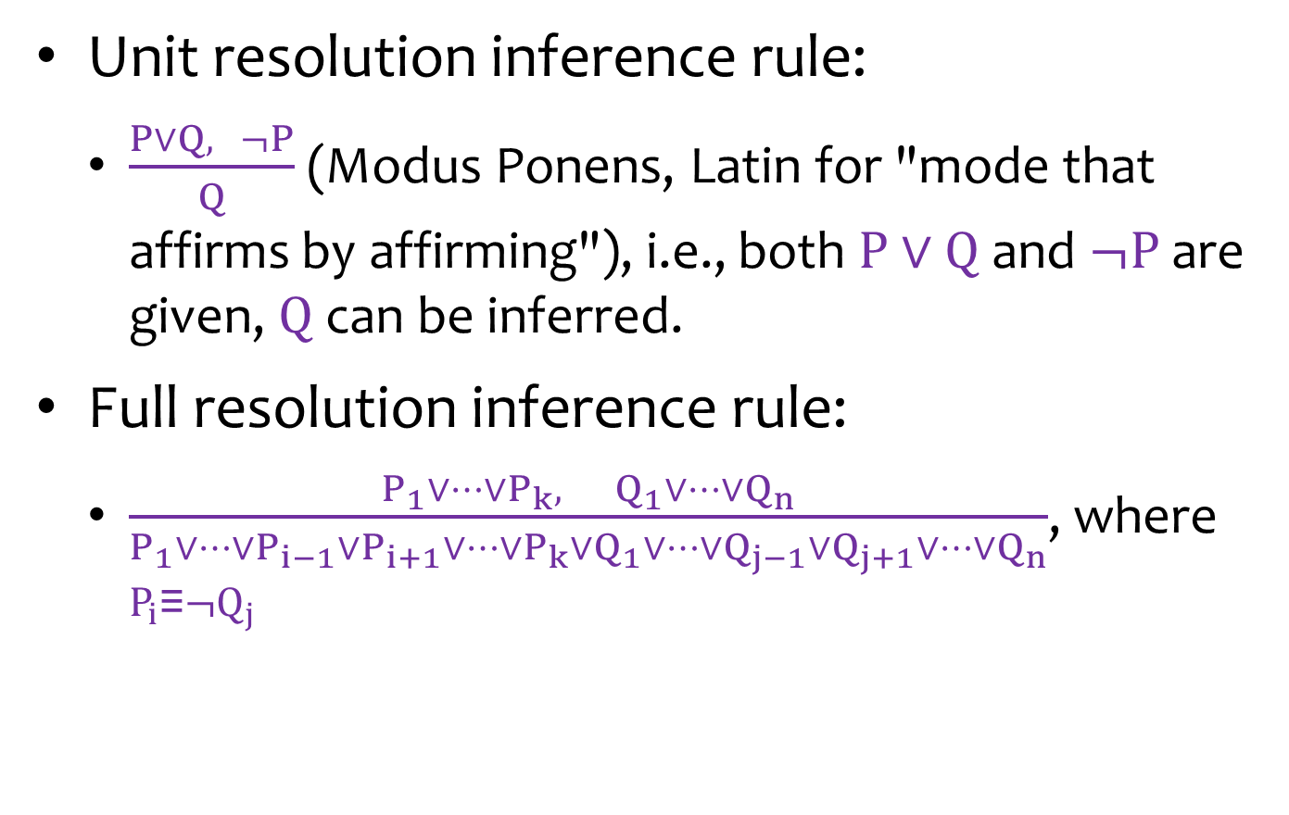
2. Applying Resolution Inference Rule
Unit resolution inference rule:
$\frac{P∨Q, ¬P}{Q}$ (Modus Ponens, Latin for "mode that affirms by affirming"), i.e., both $P∨Q$and $¬P$are given, $Q$ can be inferred.
Full resolution inference rule:
$\frac{P_{1}∨⋯∨P_{k}, Q_{1}∨⋯∨Q_{n}}{P_{1}∨⋯∨P_{i−1}∨P_{i+1}∨⋯∨P_{k}∨Q_{1}∨⋯∨Q_{j−1}∨Q_{j+1}∨⋯∨Q_{n}}$, where $P_{i}\text{≡}¬Q_{j}$

Slide 38
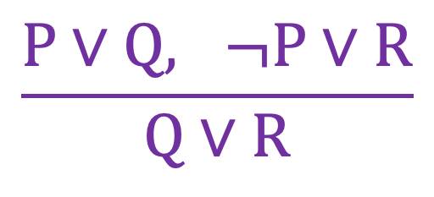
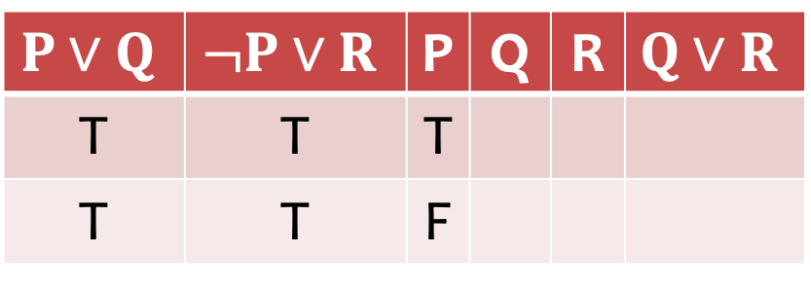
Proof through Truth Table
$$\frac{P∨Q, ¬P∨R}{Q∨R}$$
$$P∨Q$$ | $$¬P∨R$$ | P | Q | R | $$Q∨R$$
T | T | T
T | T | F
T
T
T
T

Slide 39
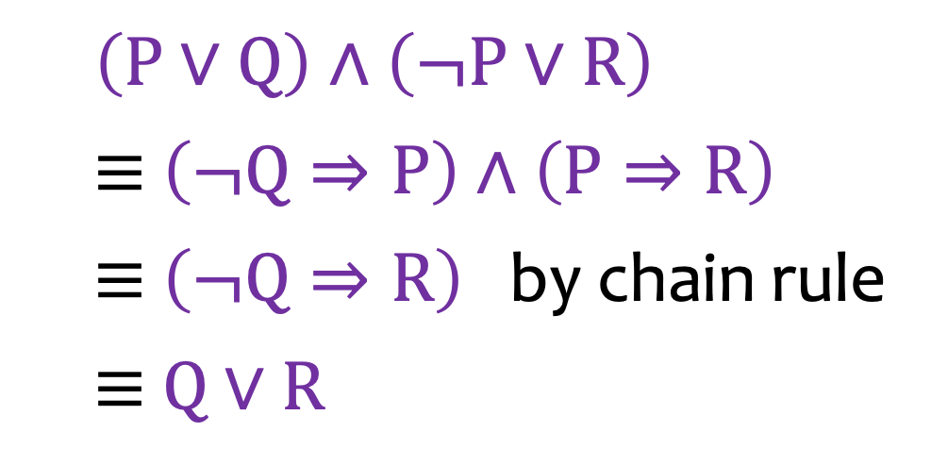
Proof through Chain Rule
$$\frac{P∨Q, ¬P∨R}{Q∨R}$$
$\left(P∨Q\right)∧\left(¬P∨R\right)$
$\text{≡} \left(¬Q⇒P\right)$ $∧\left(P⇒R\right)$
$\text{≡} \left(¬Q⇒R\right)$ by chain rule
$\text{≡} Q∨R$

Slide 40
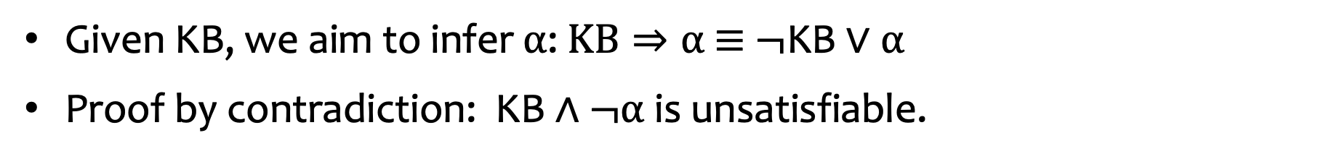
Resolution Algorithm
Given KB, we aim to infer $α$: $KB⇒α \text{≡} ¬\text{KB}∨α$
Proof by contradiction: $\text{KB}∧¬α$ is unsatisfiable.
Applying the resolution inference rule

Slide 41
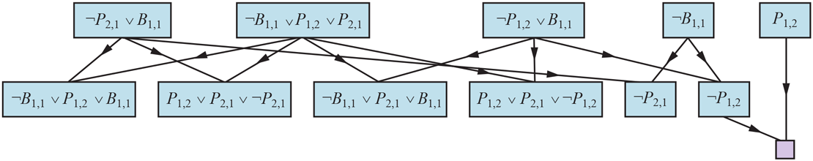
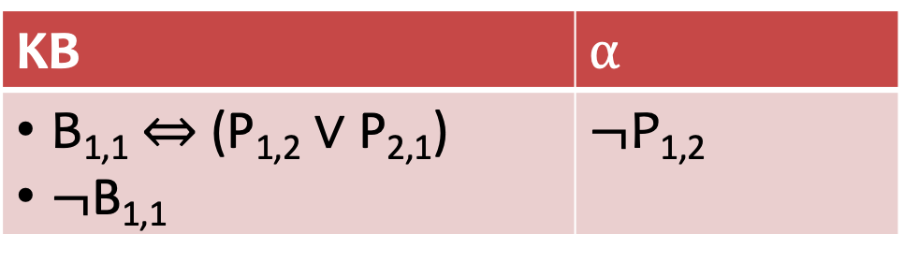
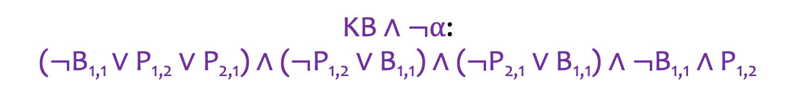
Example
KB | $$α$$
B_{1,1} $⇔$ (P_{1,2} $∨$ P_{2,1}) $¬$B_{1,1} | $$¬\text{P}\text{1,2}$$
$\text{KB}∧¬α$:
($¬$B_{1,1} $∨$ P_{1,2} $∨\text{P}\text{2,1}$) $∧$ ($¬\text{P}\text{1,2}∨\text{B}\text{1,1}$) $∧$ ($¬\text{P}\text{2,1}∨\text{B}\text{1,1}$) $∧¬$B_{1,1} $∧\text{P}\text{1,2}$

Slide 42
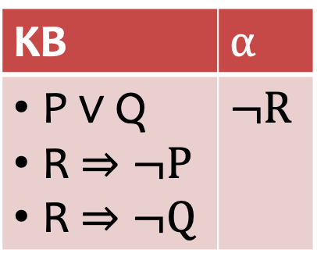
Quiz
KB | $$α$$
P $∨$ Q R $⇒¬P$ R $⇒¬Q$ | $$¬R$$

Slide 43











Quiz: Solution
KB | $$α$$
P $∨$ Q R $⇒¬P$ R $⇒¬Q$ | $$¬R$$
$\text{KB}∧¬α$:
($P∨$ Q) $∧$ ($¬R∨¬P$) $∧$ ($¬R∨¬Q$) $∧R$
$P∨$ Q
$$¬R∨¬P$$
$$¬R∨¬Q$$
$$R$$
$Q∨$ $¬R$
$P∨$ $¬R$
$$¬P$$
$$¬Q$$
$$¬R$$
$$¬R$$

Slide 44
Speedup the Algorithm
The complexity of the resolution algorithm takes polynomial time.
We can design linear-time algorithms for some restricted forms of propositional logic.

Slide 45
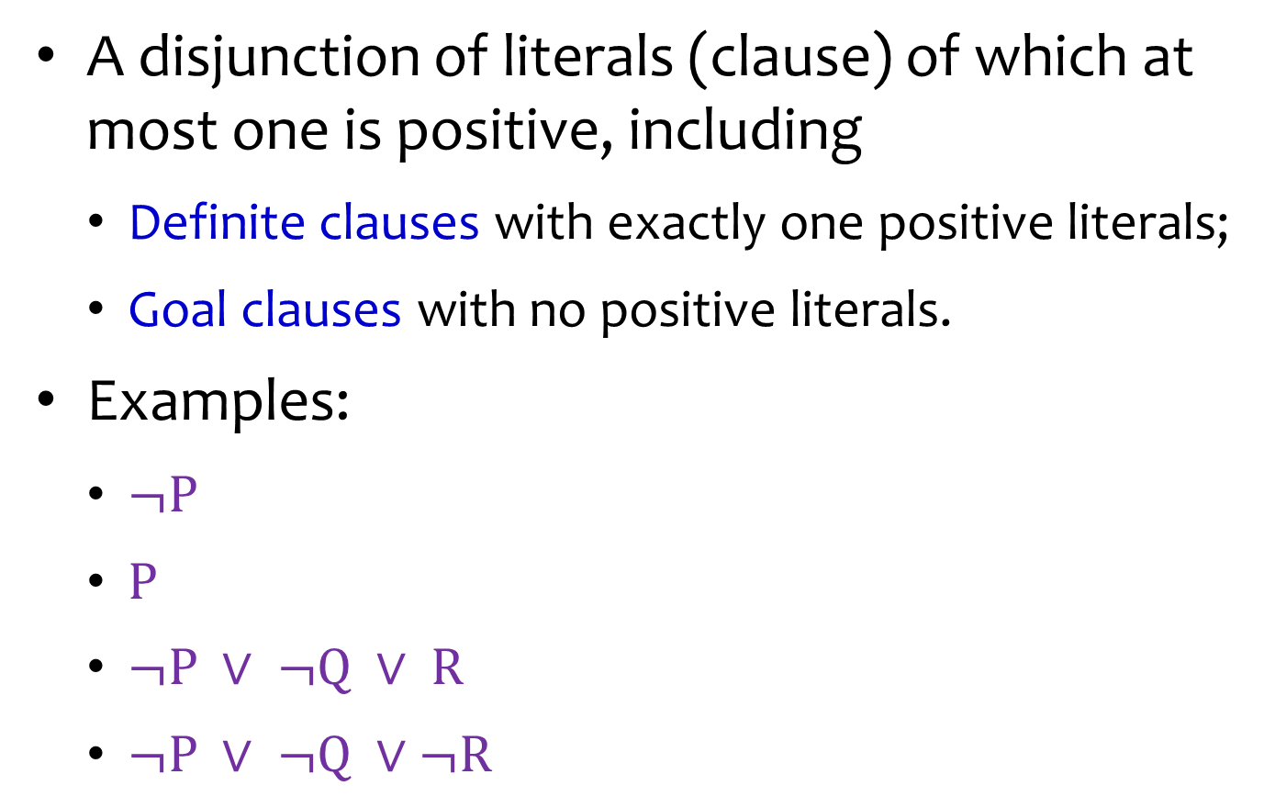
Horn Clauses
A disjunction of literals (clause) of which at most one is positive, including
Definite clauses with exactly one positive literals;
Goal clauses with no positive literals.
Examples:
$¬P$
$P$
$¬P ∨ ¬Q ∨ R$
$¬P ∨ ¬Q ∨¬R$

Slide 46

Different Perspective of Horn Clauses
Either: symbol
$\text{P}$
$¬Q$
Or: (conjunction of symbols) $⇒$ symbol
$¬\text{P}∨¬Q∨\text{R}$ ≡ $¬\text{(}\text{P}∧\text{Q}\text{)}∨\text{R}$ ≡ $\text{P}∧Q⇒\text{R}$

Slide 47

Forward Chaining
Resolution for Horn clauses (Modus Ponens):
$$\frac{P_{1}, …,{ P}_{n}, (P_{1}∧…∧P_{n})⇒Q}{Q}$$

Slide 48
Forward Chaining

Slide 49
Example
Query Q

Slide 50
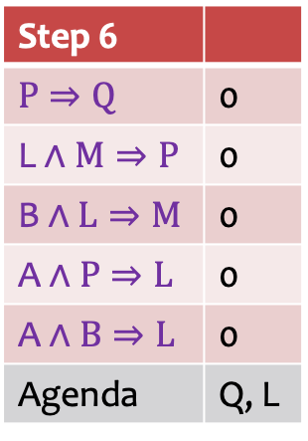
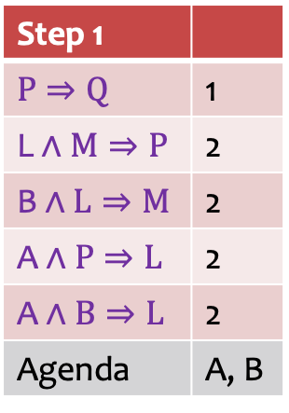
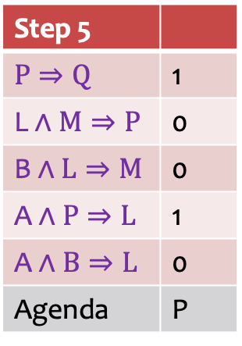
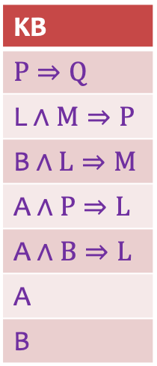
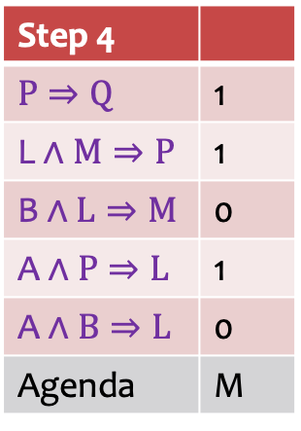
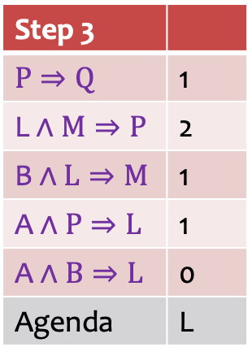
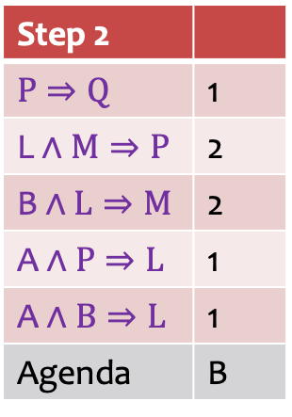
Example: Solution in Table
Step 1
$$P⇒\text{Q}$$ | 1
$$\text{L}∧M⇒\text{P}$$ | 2
$$\text{B}∧L⇒\text{M}$$ | 2
$$\text{A}∧P⇒\text{L}$$ | 2
$$\text{A}∧B⇒\text{L}$$ | 2
Agenda | A, B
Step 2
$$P⇒\text{Q}$$ | 1
$$\text{L}∧M⇒\text{P}$$ | 2
$$\text{B}∧L⇒\text{M}$$ | 2
$$\text{A}∧P⇒\text{L}$$ | 1
$$\text{A}∧B⇒\text{L}$$ | 1
Agenda | B
Step 3
$$P⇒\text{Q}$$ | 1
$$\text{L}∧M⇒\text{P}$$ | 2
$$\text{B}∧L⇒\text{M}$$ | 1
$$\text{A}∧P⇒\text{L}$$ | 1
$$\text{A}∧B⇒\text{L}$$ | 0
Agenda | L
KB
$$P⇒\text{Q}$$
$$\text{L}∧M⇒\text{P}$$
$$\text{B}∧L⇒\text{M}$$
$$\text{A}∧P⇒\text{L}$$
$$\text{A}∧B⇒\text{L}$$
$$\text{A}$$
$$\text{B}$$
Step 4
$$P⇒\text{Q}$$ | 1
$$\text{L}∧M⇒\text{P}$$ | 1
$$\text{B}∧L⇒\text{M}$$ | 0
$$\text{A}∧P⇒\text{L}$$ | 1
$$\text{A}∧B⇒\text{L}$$ | 0
Agenda | M
Step 5
$$P⇒\text{Q}$$ | 1
$$\text{L}∧M⇒\text{P}$$ | 0
$$\text{B}∧L⇒\text{M}$$ | 0
$$\text{A}∧P⇒\text{L}$$ | 1
$$\text{A}∧B⇒\text{L}$$ | 0
Agenda | P
Step 6
$$P⇒\text{Q}$$ | 0
$$\text{L}∧M⇒\text{P}$$ | 0
$$\text{B}∧L⇒\text{M}$$ | 0
$$\text{A}∧P⇒\text{L}$$ | 0
$$\text{A}∧B⇒\text{L}$$ | 0
Agenda | Q, L

Slide 51
Example: Solution in Graph
Query Q

Slide 52
Example: Solution in Graph (cont’d)
Red ring: facts unapplied
Red disk: facts applied

Slide 53
Summary: Forward Chaining
Counts the unknown premises in all clauses.
Decrease the count if a premise is known.
When a count becomes zero, the conclusion is added as a known fact.
Record the inferred symbols to avoid redundant work.

Slide 54
Backward Chaining
Work backwards from the query Q.
If Q is known, done.
Otherwise, check its premise P.
Next step check L and M.
Avoid loops: check if new sub-goal is already on the goal stack.
Avoid repeated work: check if new sub-goal has already been proved true or failed.

Slide 55
Example
Blue ring: checking
Blue disk: checked
Red disk: facts

Slide 56
Forward vs. Backward Chaining
Both time complexities are linear to the size of KB.
Forward chaining is data-driven, and may do lots of work that is irrelevant to the goal.
Backward chaining is goal-driven, and can be much less than linear in terms of time complexity.

Slide 57
Pros and Cons of Propositional Logic
Pros
It is declarative: pieces of syntax correspond to facts.
It is compositional and allows partial, disjunctive, or negated information: unlike most data structures and databases.
Meaning is context-independent: unlike natural language.
Cons
It has very limited expressive power: unlike natural language
E.g., cannot say “pits cause breezes in adjacent squares” except by writing one sentence for each square.

Slide 58
Outline
Knowledge-based Agents
Propositional Logic
First-Order Logic

Slide 59
Combining the Best of Formal and Natural Languages
When we look at the syntax of natural language, the most obvious elements are
nouns and noun phrases that refer to objects (squares, pits, wumpuses)
verbs and verb phrases that refer to relations among objects (is breezy, is adjacent to, shoots). Some of these relations are functions -- relations in which there is only one “value” for a given “input.”

Slide 60
First-Order Logic (FOL)
Propositional logic assumes world contains
Facts
First-order logic (like natural language) assumes the world contains
Objects: people, houses, numbers, theories, Ronald McDonald, colors, baseball games, wars, centuries, …
Relations: red, round, bogus, prime, multistoried, brother of, bigger than, inside, part of, has color, occurred after, owns, comes between, …
Functions: father of, best friend, third inning of, one more than, end of, …

Slide 61
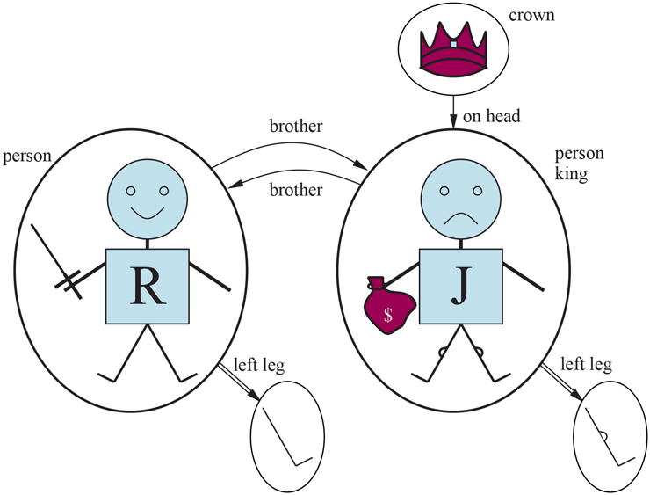
Example: Model for FOL
Five objects:
Richard the Lionheart, King of England (1189-1199);
His younger brother John, the evil King (1199-1215);
Their left legs;
A crown.
Relations (tuples):
Brotherhood: ⟨Richard, John⟩, ⟨John, Richard⟩
“on head” relation: ⟨the crown, John⟩
Functions:
“left leg”: ⟨Richard⟩ → Richard’s left leg; ⟨John⟩ → John’s left leg

Slide 62
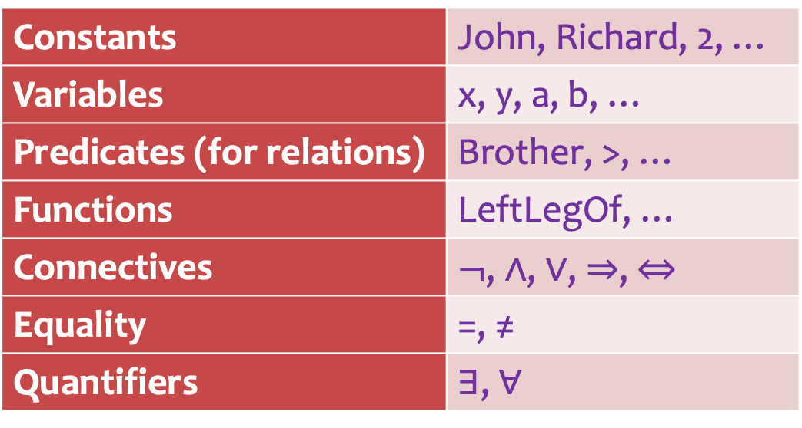
Syntax of FOL: Basic Elements
Constants | John, Richard, 2, …
Variables | x, y, a, b, …
Predicates (for relations) | Brother, >, …
Functions | LeftLegOf, …
Connectives | $¬$, $∧$, $∨$, $⇒$, $⇔$
Equality | =, ≠
Quantifiers | ∃, ∀

Slide 63
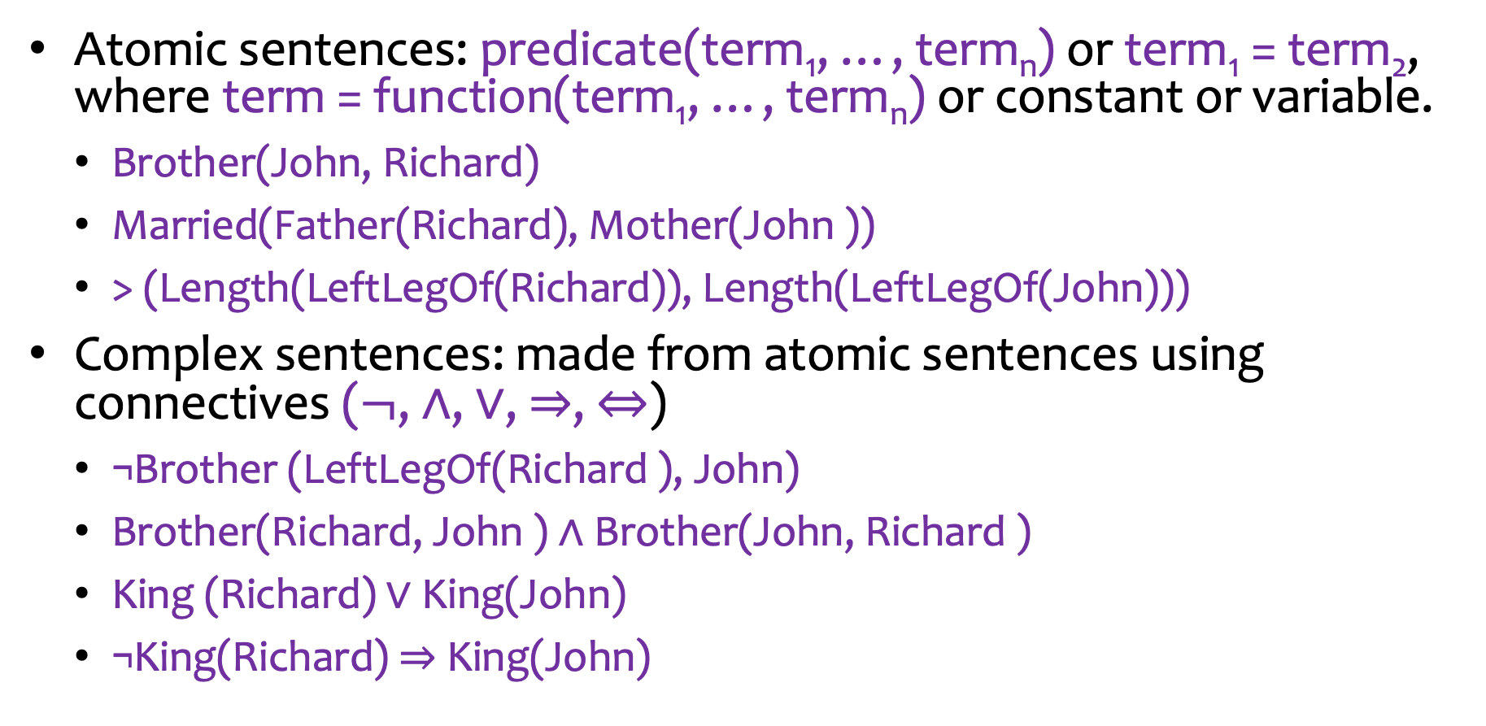
Sentences
Atomic sentences: predicate(term₁, …, term_{n}) or term₁ = term₂, where term = function(term₁, …, term_{n}) or constant or variable.
Brother(John, Richard)
Married(Father(Richard), Mother(John ))
> (Length(LeftLegOf(Richard)), Length(LeftLegOf(John)))
Complex sentences: made from atomic sentences using connectives ($¬$, $∧$, $∨$, $⇒$, $⇔$)
¬Brother (LeftLegOf(Richard ), John)
Brother(Richard, John ) ∧ Brother(John, Richard )
King (Richard) ∨ King(John)
¬King(Richard) ⇒ King(John)

Slide 64
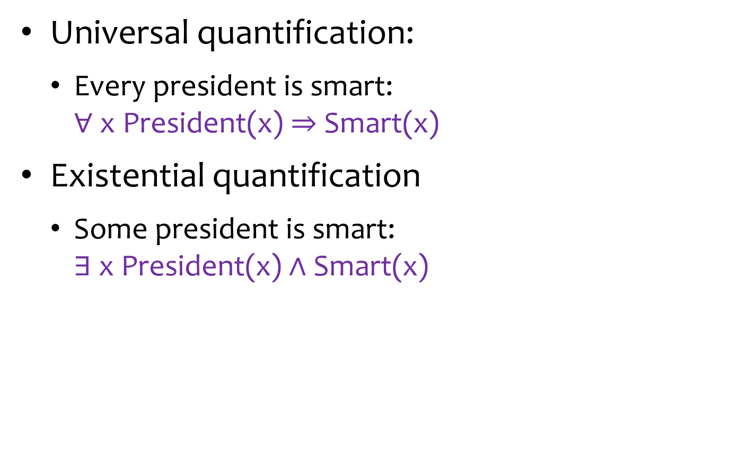
Quantifiers
Universal quantification:
Every president is smart: ∀ x President(x) $⇒$Smart(x)
Existential quantification
Some president is smart: ∃ x President(x)$∧$Smart(x)

Slide 65
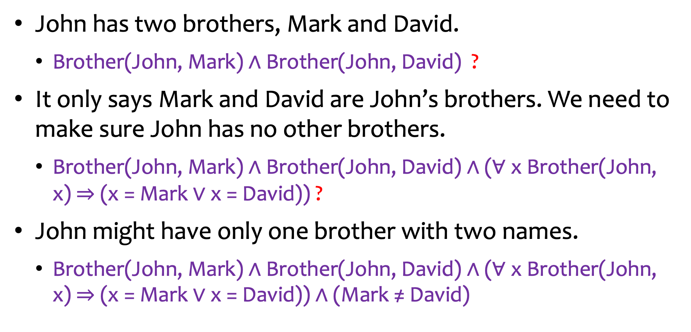
Expressing with FOL
John has two brothers, Mark and David.
Brother(John, Mark)$∧$ Brother(John, David) ?
It only says Mark and David are John’s brothers. We need to make sure John has no other brothers.
Brother(John, Mark)$∧$ Brother(John, David)$∧$ (∀ x Brother(John, x)$⇒$ (x = Mark $∨$x = David)) ?
John might have only one brother with two names.
Brother(John, Mark)$∧$ Brother(John, David)$∧$ (∀ x Brother(John, x)$⇒$ (x = Mark $∨$x = David)) $∧$ (Mark ≠ David)

Slide 66
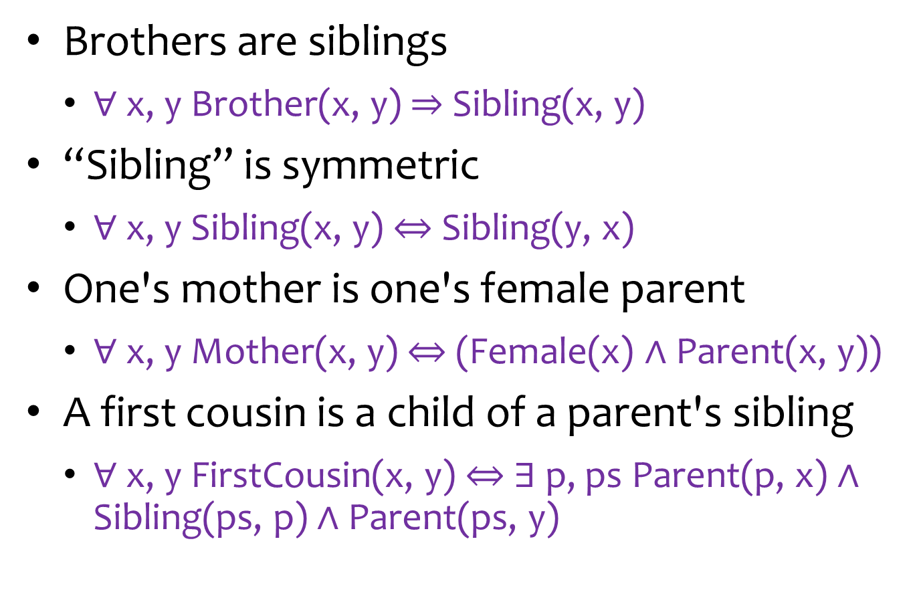
Fun with FOL
Brothers are siblings
∀ x, y Brother(x, y) $⇒$Sibling(x, y)
“Sibling” is symmetric
∀ x, y Sibling(x, y) $⇔$ Sibling(y, x)
One's mother is one's female parent
∀ x, y Mother(x, y) $⇔$ (Female(x) $∧$ Parent(x, y))
A first cousin is a child of a parent's sibling
∀ x, y FirstCousin(x, y) $⇔$∃ p, ps Parent(p, x) $∧$ Sibling(ps, p) $∧$ Parent(ps, y)

Slide 67
Interacting with FOL KBs
Assertions: sentences are added to a knowledge base using Tell.
Tell(King(John))
Tell(Person(Richard))
Tell(∀ x King(x) ⇒ Person(x))
Queries/goals: we can ask questions of the knowledge base using Ask.
Ask(King(John)): return True
AskVars(Person(x)): return a substitution or binding list {x/John} and {x/Richard}.

